Slide 1
HOW TO DO A CAMPAIGN?

Slide 2
PROGRAMME
0. What is a campaign?
1. Defining message and main contents
2. Main actors and target groups
3. Identifying the style: from institutional to peripheral
4. On and offline channels of communication
5. Strategy and calendars
6. Impact and evaluation

Slide 3
EXPECTED LEARNING OUTCOMES
To have the skills and the tools to design and implement a successful campaign.
To be able to convey a concrete message through different mediums and outlets.

Slide 4
0. WHAT IS A CAMPAIGN?
Collins dictionary: “a series of coordinated activities, such as public speaking and demonstrating, designed to achieve a social, political, or commercial goal”.
An awareness campaign
An election campaign
An advertising campaign

Slide 5
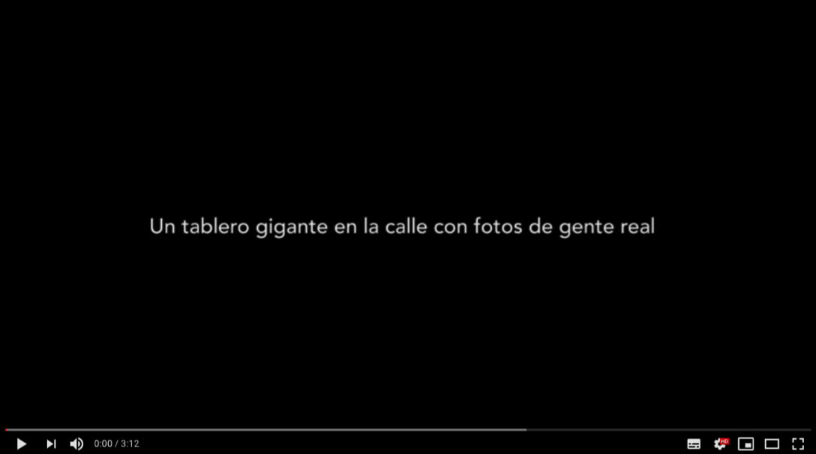
1. DEFINING MESSAGE AND MAIN CONTENTS
#esracismo campaign – SOS Racismo - Spain
https://www.youtube.com/watch?v=HjKJ7NN9xoA

Slide 6
Where are we?
Where are we going?
How do we reach it?

Slide 7
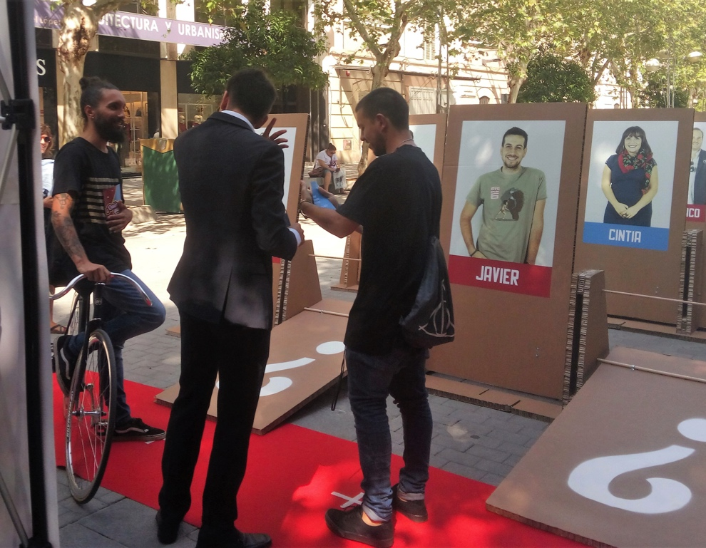
Federación SOS Racismo wants to build an antiracist and diverse society.
To achieve that, their strategy consists in fighting racism and xenophobia, mainly in Spain.
Source: https://sosracismo.eu/quien-es-quien/
Notes:
https://sosracismo.eu/quien-es-quien/
https://drive.google.com/drive/folders/1urZL9HeeoXofOfgKCchqr5vH2h3w-OIP

Slide 8
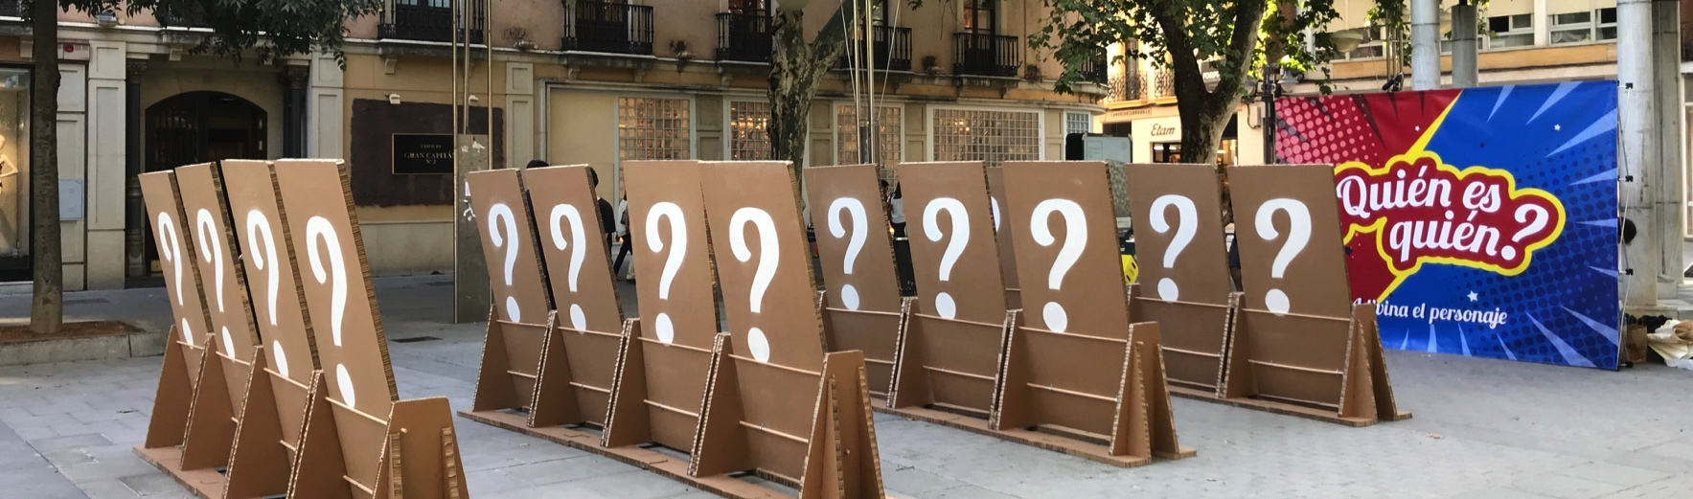
SOS Racismo implemented a campaign inspired in the game “Guess Who” for people to realize how common and hurtful stereotypes and prejudice can be.
Source: https://sosracismo.eu/quien-es-quien/
The campaign also uses #esracismo for people to denounce witnessed situations of racial discrimination, inviting the community to join the change while raising awareness for the issue.

Slide 9
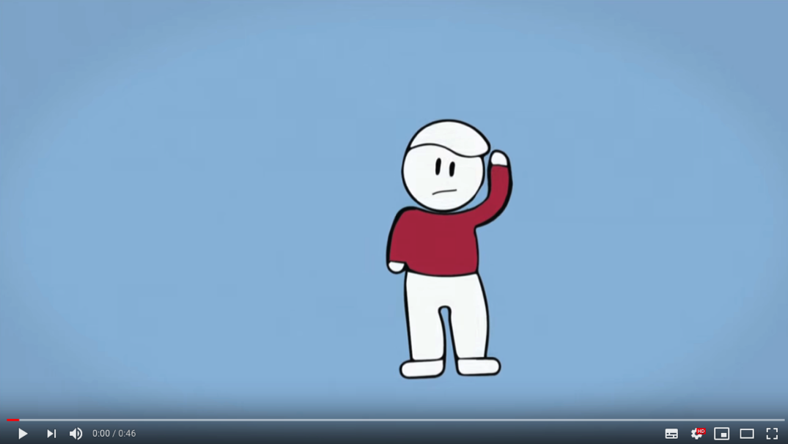
2. MAIN ACTORS AND TARGET GROUPS
“Live without bullying” – KMOP – Greece
https://www.youtube.com/watch?v=5-j74v_dQaA

Slide 10
People react differently to the same message. Identifying the target group is essential to make the best use of resources to build an effective campaign.
Each target group may share routines, interests or other experiences that distinguish them from the rest.
KMOP analyzed those characteristics to convey a core message – living without bullying – directed to different target groups through different strategies.
Adapting the same content to different formats (text, chart, video, infographic…) to make use of different platforms is essential to reach the target groups.

Slide 11
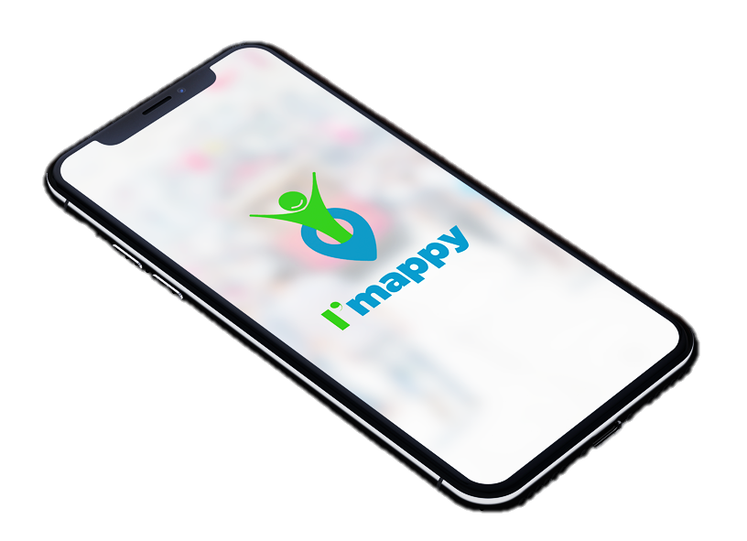
A campaign does not have to be directed to everyone. Attempting it is unreasonable and a likely waste of resources.
Imappy is an app in development for young refugees living in Europe. This project aims to provide social and basic information about their asylum countries.
Refugees in Europe often depend on smartphones to navigate and to request assistance, so an app is an effective way of reaching this target group.
The information and support provided by the app is specifically designed to meet the needs and expectations of refugees – including Arabic translations – as a unified target group allows more detailed approaches.
Source: https://www.imappy.org/

Slide 12
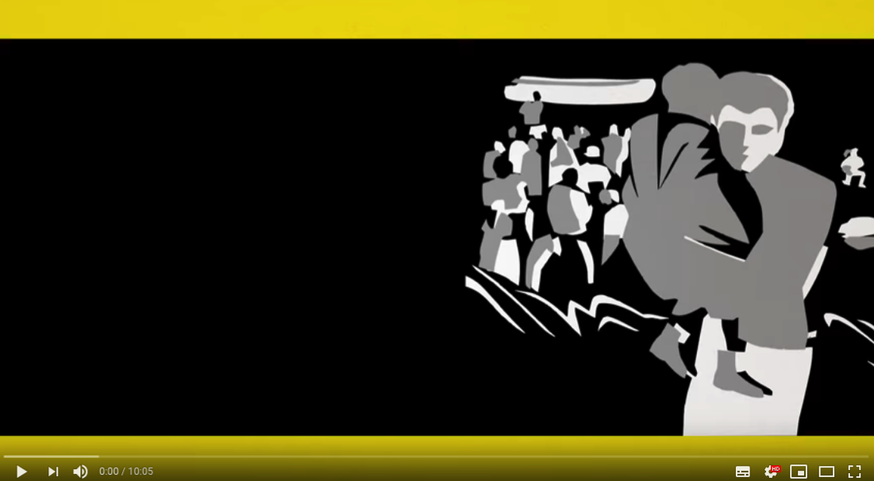
3. IDENTIFYING THE STYLE: FROM INSTITUTIONAL TO PERIPHERAL
“Understanding the refugee crisis” – Amnesty International – France
https://www.youtube.com/watch?v=NgZ5c5cRn7Y

Slide 13
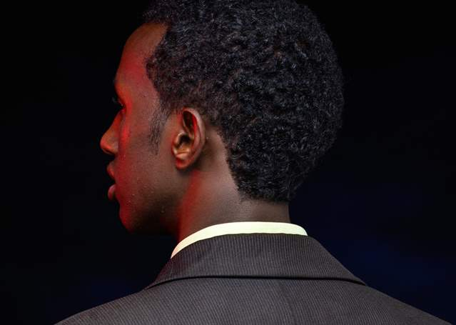
Amnesty International often uses animations and colours to approach serious subjects, such as death penalty, human rights, refugees and war. This strategy increases the reach of their campaigns, making their campaigns flexible and suitable for unconventional circumstances.
Providing a distinctive personality to a campaign is key to make it stand out from the rest.
“I am Hussein.
I am an actor.
I am a reader of novels.
I am a refugee”
Source: https://www.amnesty.org/en/latest/news/2015/03/i-define-me/
Notes:
https://www.amnesty.org/en/latest/news/2015/03/i-define-me/
https://www.amnesty.org/es/about-us/permissions/

Slide 14
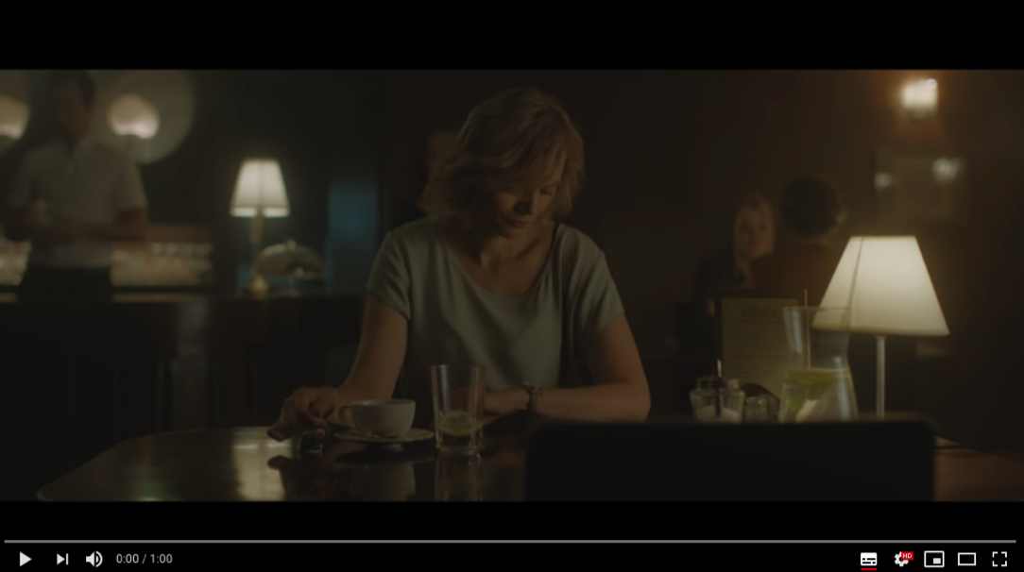
4. ON AND OFFLINE CHANNELS OF COMMUNICATION
“Support Survivors” campaign – Office of Equal Opportunities Ombudsperson - Lithuania
https://www.youtube.com/watch?v=2KrHsqiwnQY

Slide 15
The “Support Survivors” campaign addresses the institutions and people that domestic violence victims rely on, such as friends, family, police officers, priests, judges and child rights protection staff, encouraging them to listen and support these victims, particularly women.
Such a broad target group demands a well coordinated strategy to reach them, including on and offline channels of communication.
Besides being available online, this video was also broadcasted on TV, cinemas and radio. Additionally, posters were distributed in different cities.

Slide 16
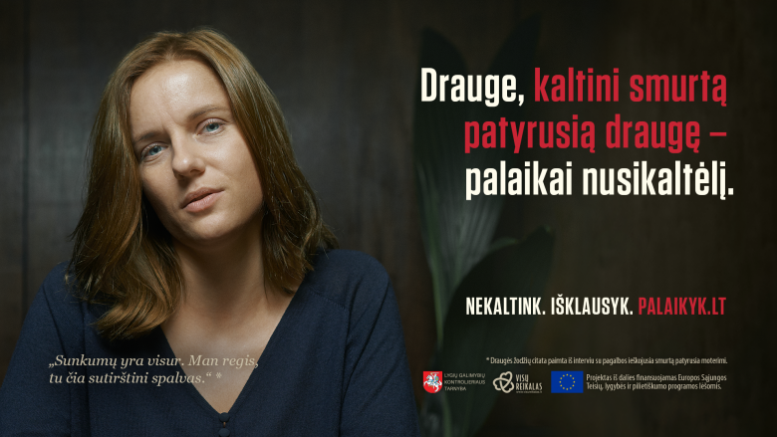
“Blaming the victim means supporting the offender” could be read in posters all over Lithuania. These posters included all the different characters from the video and real statements said to women victims of violence.
This consistent mix of online and offline resources allows conveying the message effectively.
Source: https://www.visureikalas.lt/en/campaign-support-survivors
“Difficulties are everywhere. I think you are exaggerating”
Notes:
https://www.visureikalas.lt/en/campaign-support-survivors

Slide 17
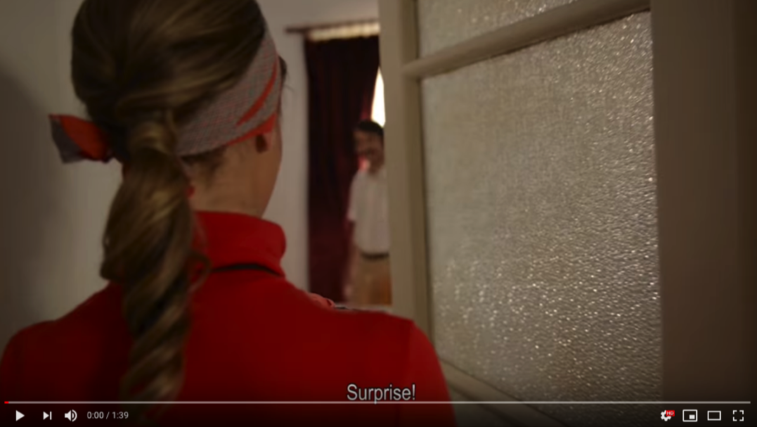
5. STRATEGY AND CALENDARS
AWARE campaign – Opinion & action - Cyprus
https://www.youtube.com/watch?v=dcee16tZkO8
Notes:
https://www.youtube.com/watch?v=dcee16tZkO8

Slide 18
Creating a plan that includes short term and long term activities is essential to achieve campaign goals. Defining the best moment to implement or to promote an activity may be the difference between failure and success.
It is important to articulate the dissemination of all the produced work in different platforms. Since some results are immediate and others are not, a logical and planned sequence must be followed for them to benefit each other.

Slide 19
The AWARE campaign seeks to highlight the lives of refugees, asylum seekers and migrants in Cyprus. To achieve that, a set of seminars, workshops, short films, events, festivals and TV appearances were put together.
AWARE makes use of their TV appearances not only to raise awareness about the situation of this group in Cyprus, but also to promote other related activities they develop. All these activities are also available on their website, further increasing their reach.
http://cyprusaware.eu/en/the-aware-activities/

Slide 20
6. IMPACT AND EVALUATION
This stage does not represent the end of the campaign, but rather a chance to improve it.
What can be improved is determined by assessing the quantitative and qualitative results of the campaign.
It is a chance to change what does not get results, to improve what does not seem to be working as planned and to analyse what exceeded the expectations.
Assessing the impact and evaluation requires implementing follow ups to guarantee that the campaign stays faithful to the initial plan.
This stage is a learning process that requires asking questions:

Slide 21
Is it realistic to insist on it until the results appear?
Do the results match the predictions?
Was the calendar too tight?
How is it different from the rest?
Why weren’t the objectives reached?
Why isn’t an activity working?
What campaign activity was the most successful?
Was the strategy adequate?
Were the expectations realistic?
Were the goals achieved?
How to measure the results?
Is it better to drop it?
What external factors affected the campaign?

Slide 22
The #FATIproject www.projectfati.com (2017-3-CY02-KA205-001111) has been co-funded with the support of the European Union. Its contents and materials are the sole responsibility of its authors. The European Commission is not responsible for the use that may be made of the information disseminated here.

